Slide 1
Lab 5
Mathilde Krafft

Slide 2
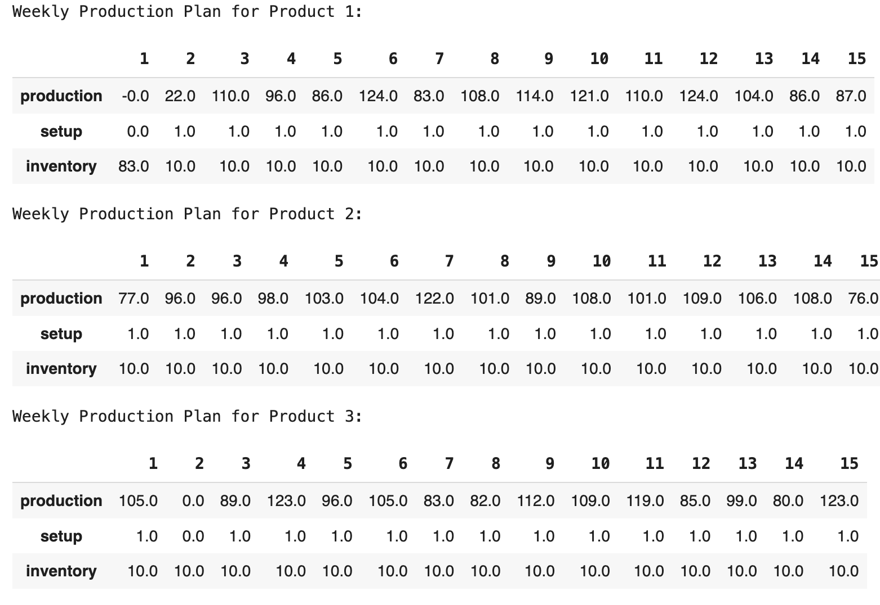
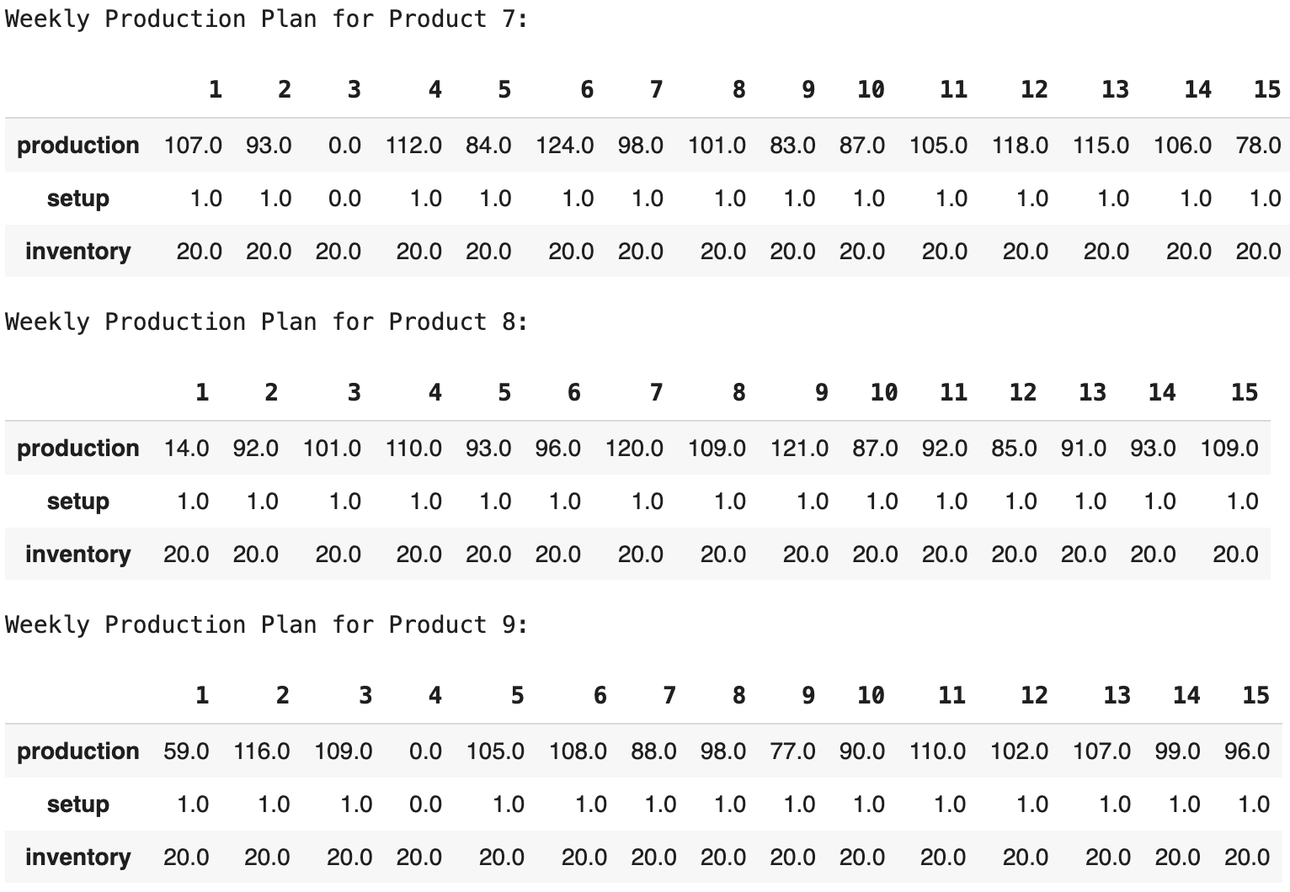
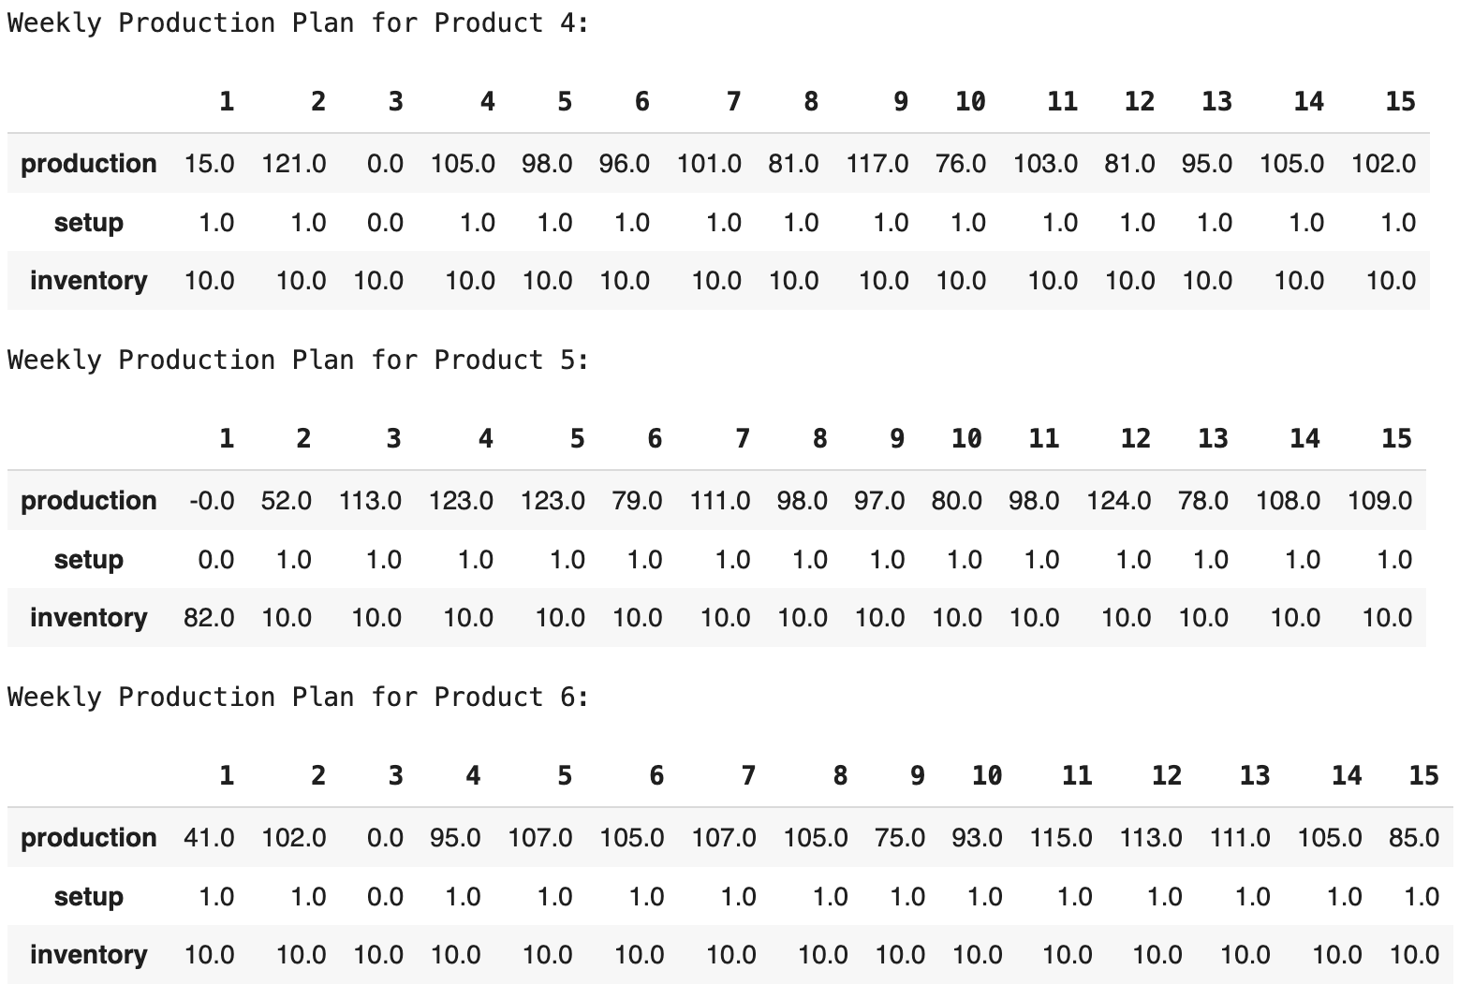
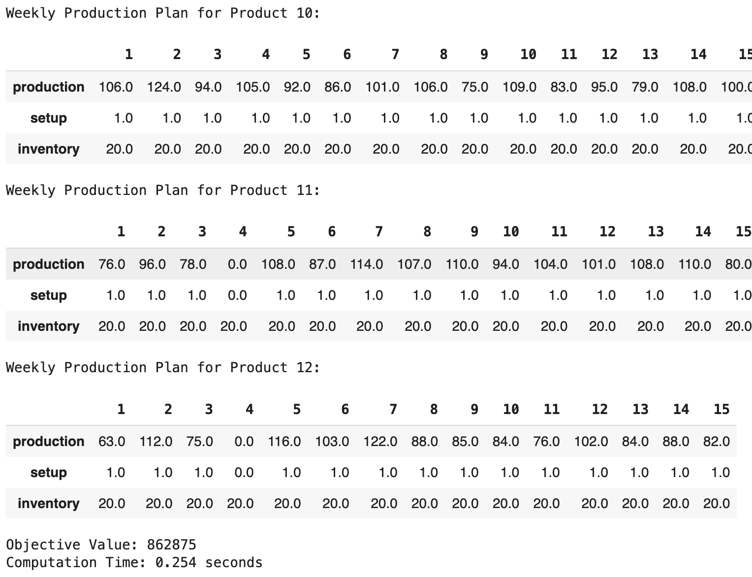

Slide 3
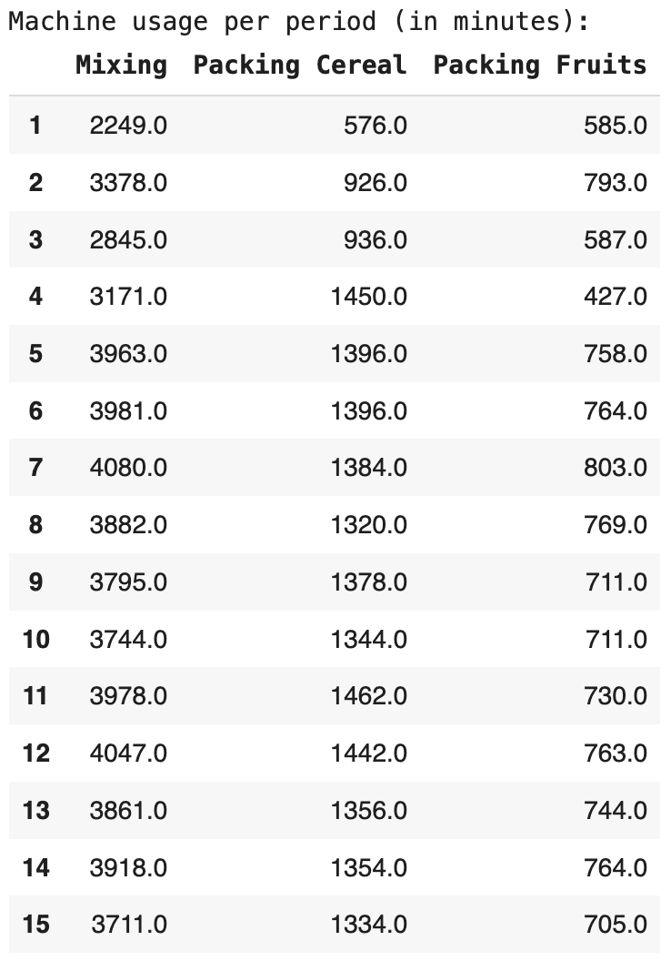
Potential problems
The constraints aren’t constrainning
Is it normal that the production always match → Demand + safety stock ?
I calculate the number of available minutes per machine per
week like that : e.g 2*38*60 for the mixing machine.

